Slide 1

AuE-8230 Autonomy: Science and Systems
Capstone Project
Group 1: Chinmay Samak, Tanmay Samak
Codebase

Slide 2
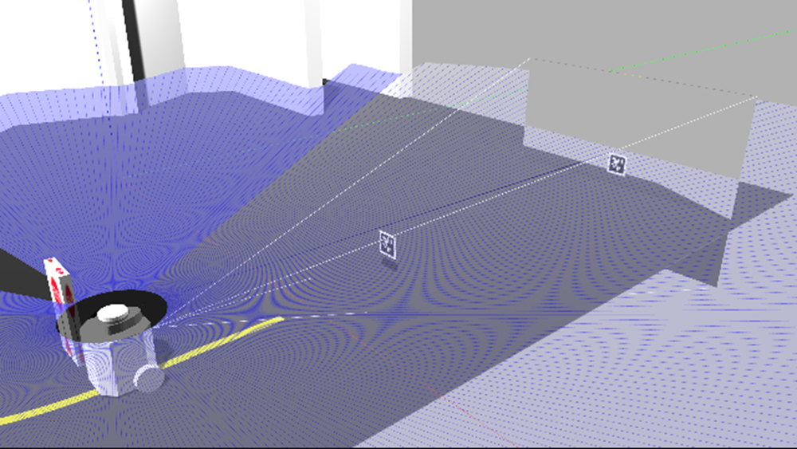
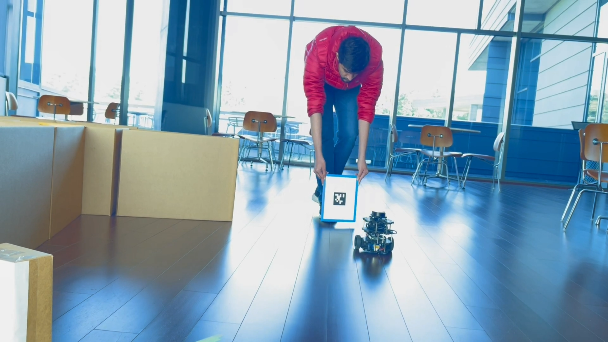
Task 5
AprilTag Tracking

Slide 3

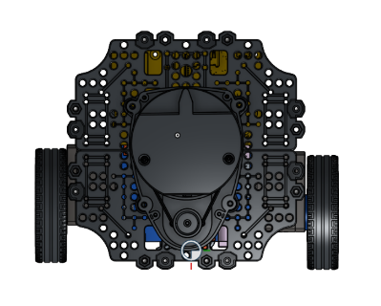

Approach
$$\left[0:h\right], \left[0:w\right]$$
Sensors: Camera (compressed/uncompressed | 320x240 px)
Algorithm:
Configure & run AprilTag detection on incoming image
Estimate 6D metric pose of marker w.r.t. robot’s camera (intrinsics)
Apply static transform from base_link to camera
Operate on lateral (-x) & longitudinal (z) deviation from marker
Stop if too close
De-coupled lat-lon PID controller architecture
Safety mechanisms and bounds (actuation limits)
Alternate approaches:
Print quality
Tag size

Slide 4
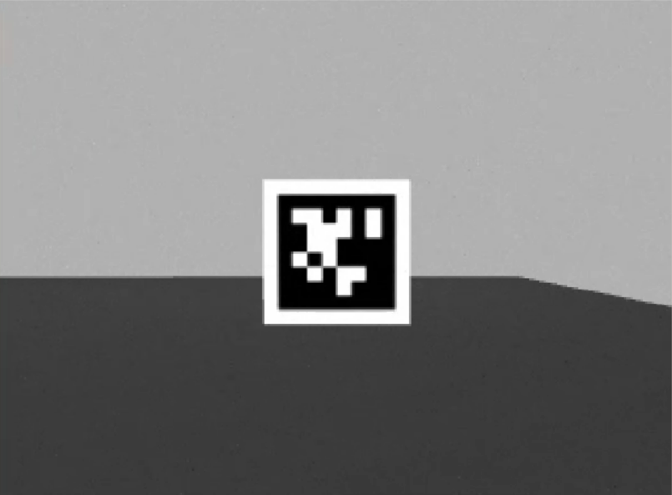
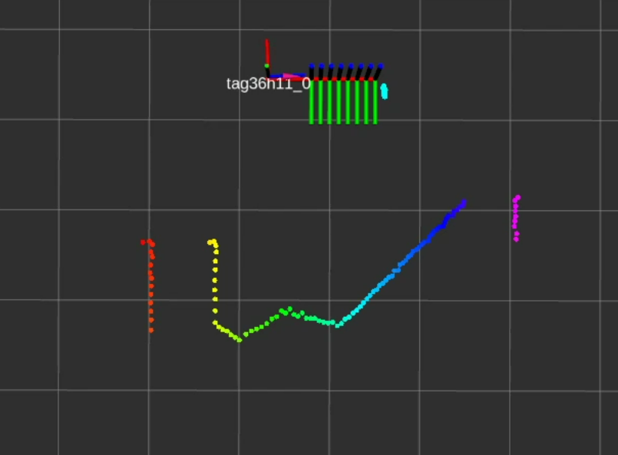
Approach
AprilTag
Sensors: Camera (compressed/uncompressed | 320x240 px)
Algorithm:
Configure & run AprilTag detection on incoming image
Estimate 6D metric pose of marker w.r.t. robot’s camera (intrinsics)
Apply static transform from base_link to camera
Operate on lateral (-x) & longitudinal (z) deviation from marker
Stop if too close
De-coupled lat-lon PID controller architecture
Safety mechanisms and bounds (actuation limits)
Alternate approaches:
Print quality
Tag size
TurtleBot3

Slide 5


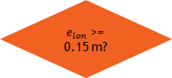



Approach
START
Initialize
Subscribe Image
Sensors: Camera (compressed/uncompressed | 320x240 px)
Algorithm:
Configure & run AprilTag detection on incoming image
Estimate 6D metric pose of marker w.r.t. robot’s camera (intrinsics)
Apply static transform from base_link to camera
Operate on lateral (-x) & longitudinal (z) deviation from marker
Stop if too close
De-coupled lat-lon PID controller architecture
Safety mechanisms and bounds (actuation limits)
Alternate approaches:
Print quality
Tag size
Subscribe AprilTag Detections
AprilTag Detection
No
Tag
Family is 36h11?
Yes
No
Tag ID is 0?
Transform
$$TF= ^{cam}T_{tag}$$
Yes
$e_{lon}$ >= 0.15 m?
Yes
Yes
No
Tag Size is 0.0762?
Error
$$e_{lon}=TF.z$$
$$e_{lat}=−TF.x$$
No
LIN_VEL = $v$
ANG_VEL = $ω$
ANG_VEL = PID_LAT($e_{lat}$)
LIN_VEL = 0
LIN_VEL = PID_LON($e_{lon}$)
Bound LIN_VEL and ANG_VEL
Publish CMD_VEL =
{LIN_VEL, ANG_VEL}
END

Slide 6
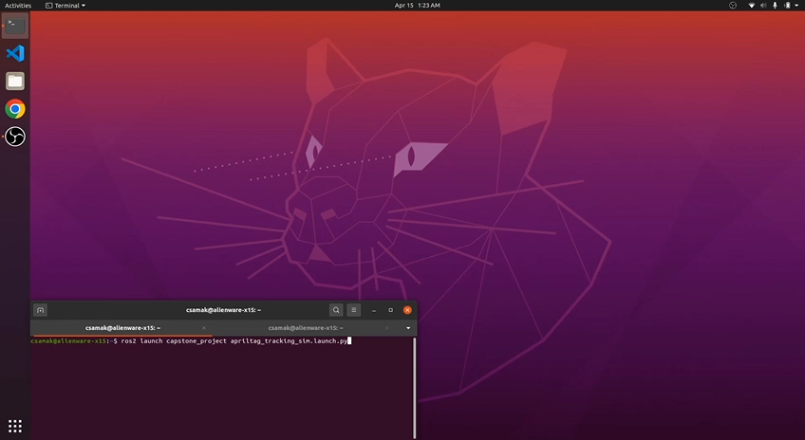
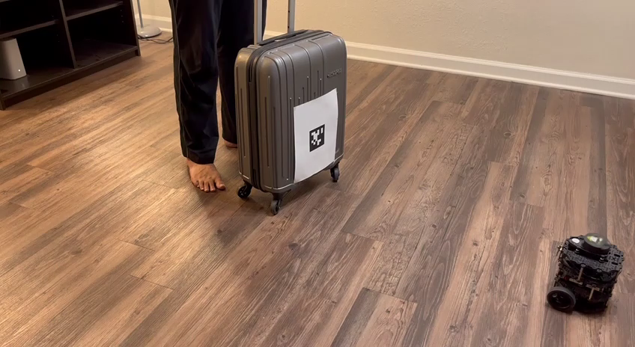
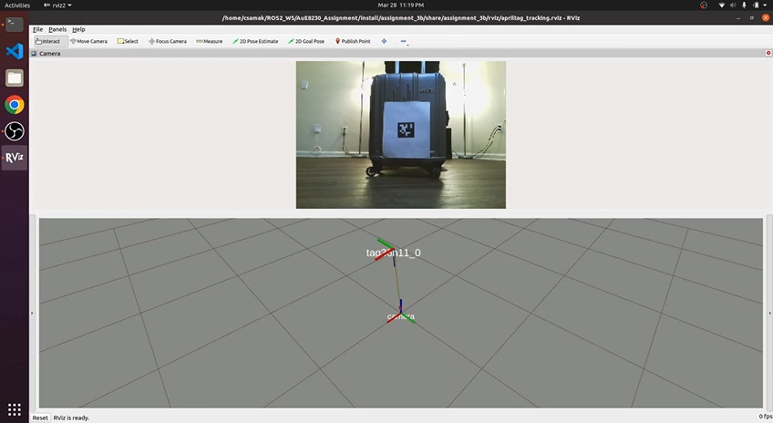
Results
Simulation
TurtleBot3
Remote PC

Slide 7
Thank you!
…open to questions and suggestions

